Slide 1
NWSEO CBA Negotiation Team
Mission Statement: To craft the best Collective Bargaining Agreement (CBA) possible

Slide 2
NWSEO CBA Negotiations Update
July 16th, 2015: Notification from David Murray, regarding the NWS Agency of termination of the Collective Bargaining Agreement (CBA) and proposed changes, was sent to NWSEO Leadership - minutes before the unexpected notification was sent agency wide.
July 17th, 2015: Dan Sobien submitted form F-7 to the Federal Mediation and Conciliation Service (FMCS), fulfilling NWSEO’s obligation under Article 29 Section 3 of the CBA:
“This Agreement will remain in effect for 90 calendar days from the start of formal renegotiation or amendment of said Agreement, exclusive of any time necessary for FMCS or FSIP proceedings. If at the end of the 90-calendar day period an agreement has not been reached and the services of neither FMCS nor FSIP have been invoked, either party may, upon written notification to the other, terminate any or all sections of the Agreement.”
July 22nd, 2015: NWSEO team appointments:
Dan Sobien, NWSEO President, Meteorologist and Chief Negotiator. Tampa Bay, FL
Dave Solano, NWSEO Secretary-Treasurer, Eastern Region Chair and Senior Hydrometeorologist. Middle Atlantic River Forecast Center, State College, PA.
Steve Pritchett, NWSEO HQ Chair and Meteorologist, Silver Spring, MD.
JoAnn Becker, NWSEO NCEP Chair and Meteorologist at the Aviation Weather Center, Kansas City, MO.
John Werner, NWSEO Southern Region Chair and Lead Forecaster, Mobile, AL.
Suzanne Sims, NWSEO Western Region Chair and Lead Forecaster, Monterey, CA.
Robert Ruehl, NWSEO Western Region Vice-Chair and Observation Program Leader, Eureka, CA.
Nathan Becker, NWSEO Pacific Region Vice-Chair and Oceanographer Ph.D. Pacific Tsunami Warning Center, Ewa Beach, HI
Delyne Kirkham, NWSEO Credentials Committee Co-Chair and Hydrometeorology Technician. Previously an Administrative Assistant. Elko, NV.
Notes:
Bill Hopkins, Richard Hirn and Lisa Luciani are also integral to the success of the team. We are additionally utilizing them, and multiple other, resources.
Robert Ruehl – Robert is an OPL is very knowledgeable of the observing program. Among other things the observing program has some very unique travel issues that will need to be addressed.
Delyne Kirkham – Delyne is an HMT that also used to be an ASA. By selecting her I am getting two perspectives for the price of one. Delyne also works in a remote, small population office and I think that perspective will be very valuable. For instance if we are talking about child care or elder care or health facilities, my guess is reality is a little different in Elko Nevada than it is in Washington DC.
Nathan Becker – Nathan Becker works in a Tsunami Forecast office, their program doesn’t even have a meteorological connection and geographically he works in an office that is closer to Tokyo than Washington DC.
Dave Solano – works in the Hydrology program an area where the agency is expecting to make many changes in the next few years.
John Werner – John is a lead forecaster in Mobile Alabama. The Mobile WFO is a hurricane prone, tornado prone marine environment. John was also a point of contact for the agency in developing the Weather Ready Nation program.
Suzanne Sims – Suzanne is a lead forecaster in the Monterey office and our Western Region Chair. Monterey is also a marine office but with a whole different set of issues than the Atlantic offices. Suzanne also has experience in other Western Region offices and in fact grew up in Arizona. Her knowledge of mountain meteorology plus the fire weather and IMET programs will be very useful.
JoAnn Becker – JoAnn works at and represents national centers. The reality of working conditions at say the National Hurricane Center is very different than that of a WFO or RFC.
Steve Pritchett – Steve works at and represents the National Headquarters. HQ contains nearly one quarter of the employees that work in the NWS and their working conditions are very different than operational units. For instance telecommuting is almost impossible in a WFO environment, could perhaps be done seasonally at some NCEP Centers but at HQ could be a great benefit to both the agency and employees.

Slide 3
NWSEO CBA Negotiations Update
July 24th, 2015: Notified Ken Brown and David Murray of the names of the team members
and the dates of the meetings that met the requested timeline from NWS.
August 3rd, 2015: Notification from Ken Brown, agreeing to the meeting dates for the ground
rules negotiation for the week of August 31st in Florida and September 28th in Washington DC.
August 5th, 2015: Dan Sobien submitted the email addresses to Ken Brown and for notification to the ground rules negotiation team member’s supervisors.
August 5th, 2015: Ken Brown responded that the number of the team be limited to 3.
August 5th - 19th, 2015: Dan Sobien and FMCS worked on the team number agreement with Ken Brown. On August 19th, Mr. Brown stated that there was an “impasse.” NWSEO feels this issue could still be bargained.
August 21st, 2015: Ken Brown filed an application with the Federal Service Impasses Panel (FSIP).
August 23rd, 2015: Ken Brown and Dan Sobien signed a Memorandum of Understanding (MOU) specifying the number of the team members at the negotiating table, after working with FSIP.
What is the Federal Mediation and Conciliation Service (FMCS)? FMCS mediators can communicate with both labor and management parties to a collective bargaining agreement prior
to the start of negotiations. Negotiating parties file an F-7 Notice of Bargaining. A mediator can provide assistance. https://www.fmcs.gov/
What is the Federal Service Impasses Panel (FSIP)? The Panel resolves impasses between Federal agencies and unions representing Federal employees. A bargaining impasse occurs
when the two sides negotiating an agreement are unable to reach an agreement and become deadlocked. https://www.flra.gov/fsip

Slide 4
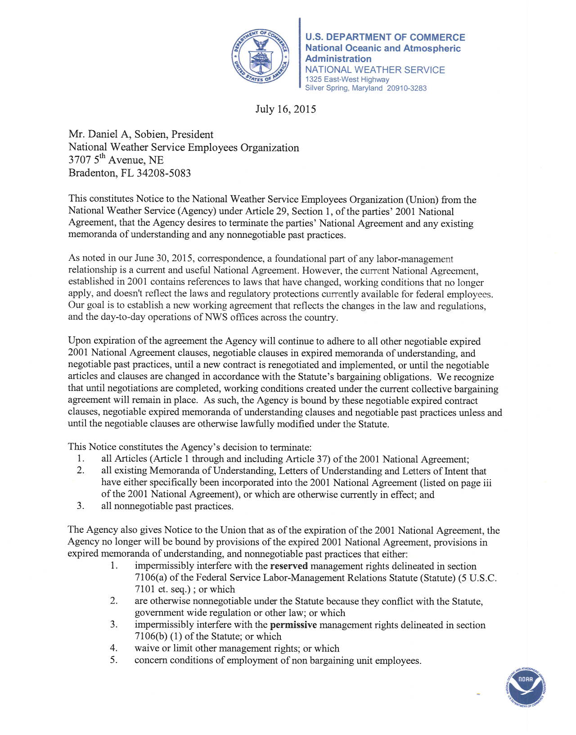
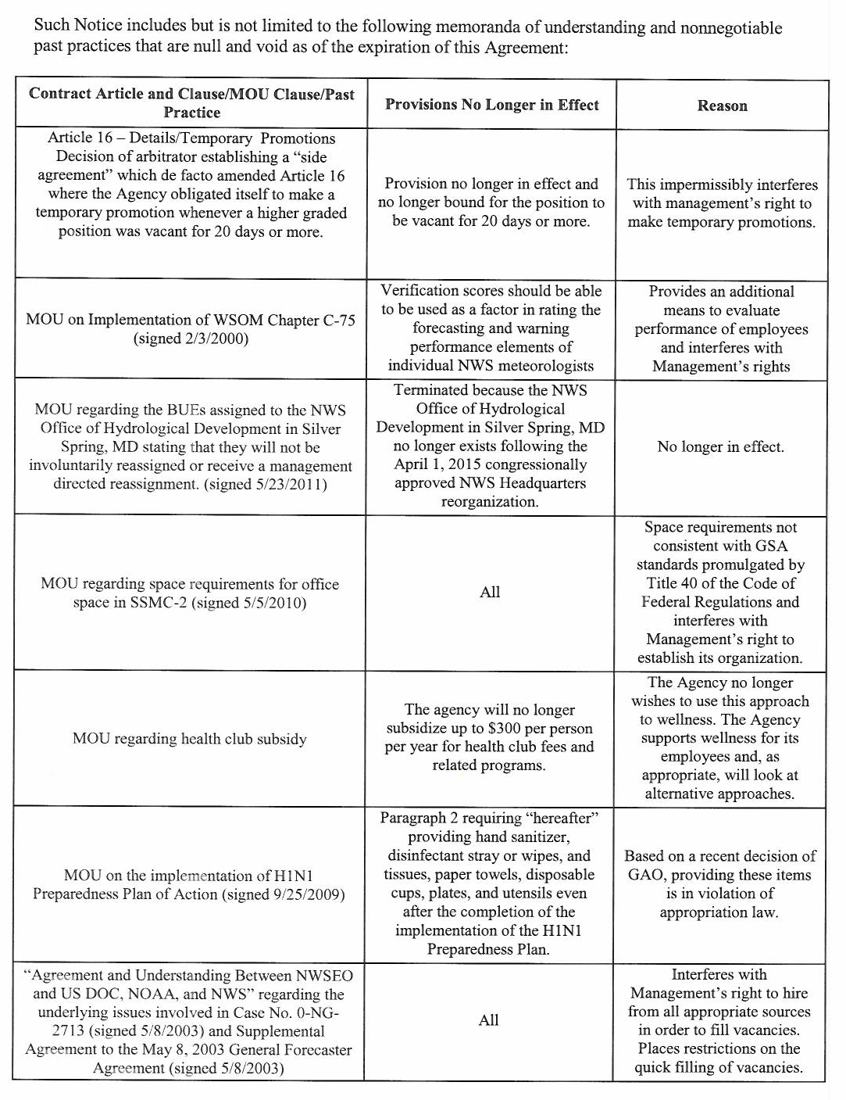
Notes:
7/16/2015 NWS Notice of Decision to Terminate Collective Bargaining Agreement

Slide 5
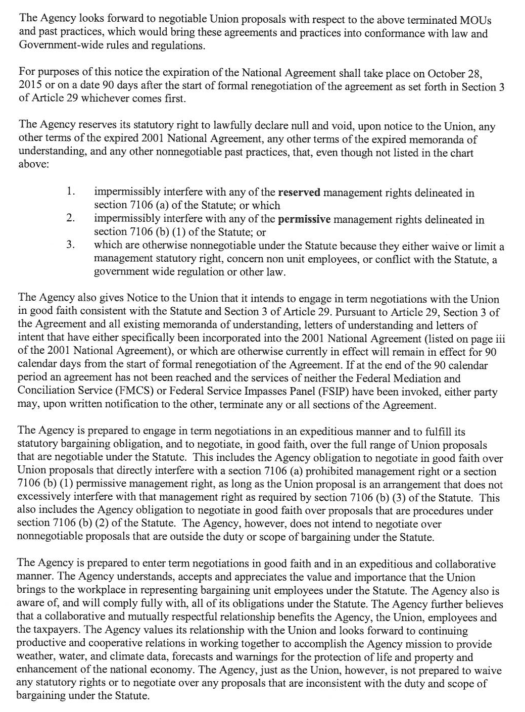

Slide 6
What are the Sub-Team Goals?
Sub Team 1 – Review existing CBA
Sub Team 2 - Evaluate Other CBAs
Sub Team 3 - Brainstorm & Incorporate New Ideas
#2
#3
#1

Slide 7
Sub-Team 1
Sub-team #1 Goals:
Review the existing contract
Discern items NWSEO would like to keep
Identify items to change
For items governed by specific laws, get clear interpretations
Determine “at risk” items that NWS may target,
Identify common interests that we can seek out, etc.
Bottom line; garner the best
and eliminate the chaff
in the current CBA.
#1 Sub-team Coordinator: Delyne Kirkham
delyne@gmail.com or 775-397-1993

Slide 8
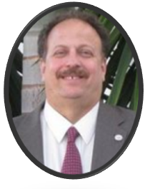
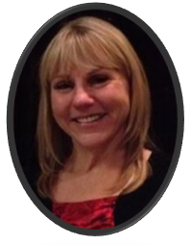
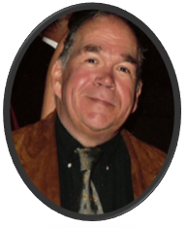
Sub-Team 1 Members...
Dan Sobien-Chief Negotiator
president@nwseo.org
Delyne Kirkham
Team Coordinator
delyne@gmail.com
775-397-1993
Steve Pritchett
s.pritchett@nwseo.org

Slide 9
Sub-Team 1 update
Team #1 created a CBA google document and emailed the link to NWSEO Branch Stewards for responses, ideas, feedback
Sub-team coordinator put a message on Facebook to ask members for feedback
Each team member continues to go through the CBA to accomplish the sub-team goal and to develop a core list of CBA ideas
Scheduled a sub-team meeting for Monday, September 28th

Slide 10
Sub-Team 1 update - continued
Is actively requesting and receiving current CBA ideas and feedback from members (via email and/or the copy of the CBA "Suggestions from branches for COLLECTIVE BARGAINING AGREEMENT").
Please email delyne@gmail to request google document link to provide input for the CBA.

Slide 11
Sub-Team 2
Sub-team 2 Goals:
Review CBAs for other federal unions
Cross reference index of CBA sections
Collect language for foundational sections of our CBA
Identify Articles which could be added to the next NWSEO CBA
Evaluate and identify new and existing articles that may improve the NWSEO CBA
#2 Sub-team Coordinator: JoAnn Becker j.becker@nwseo.org

Slide 12
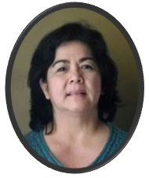
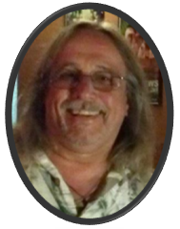
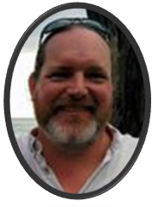
Sub-Team 2 Members...
JoAnn Becker
Team Coordinator
j.becker@nwseo.org
Robert Ruehl
mingdamerciless@rocketmail.com
Nate Becker
nathan.c.becker@gmail.com

Slide 13
Sub-Team 3
Sub-team #3 Goals:
Sub-team Goal: To brainstorm ideas and proposals that would improve employees’ work/life.
Anything that can assist employees in fulfilling various needs and goals, or minimize challenges, for healthy work/life.
Bottom line; generate and assess
innovative options and solutions
that would benefit employees.
#2 Sub-team Coordinator: Suzanne Sims s.sims@nwseo.org

Slide 14
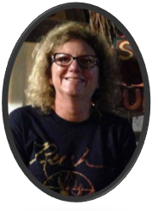
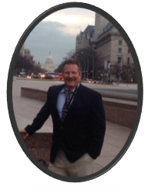
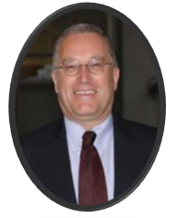
Sub-Team 3 Members...
Suzanne Sims
Team Coordinator
s.sims@nwseo.org
John Werner
nwseosr_chair@yahoo.com
Dave Solano
hydrodave2@comcast.net

Slide 15
Sub-Team 3 update
Our team is compiling a big wish list of items that would serve to enhance the work life of NWS employees. So far we have quite a few items, but we welcome suggestions from our members!

Slide 16
NWSEO CBA Negotiation Team
Remember, this is a PROCESS.
We will take ideas, but please keep in mind that it is unrealistic to expect that every suggestions will be fulfilled. There will likely be a lot of give-and-take during negotiations.

Slide 17
Questions, Feedback, Suggestions?
No one cares more for National Weather Service employees
than National Weather Service employees!

